Slide 1
Objectives in this Section
Previously: Simple models of metals. For improvements, we need the band structure.
By the end of this section you should be able to:
Determine the number of points on a band
Calculate heat capacity for metals
Conceptually explain why energy bands and band gaps develop (two different approaches)
Use/define Bloch’s Theorem
Coming up soon: Calculating energy bands
Notes:
If time, we’ll use what we’ve learn to apply this to predict the energy band diagram for a chain of F atoms

Slide 2
The Quantum Metal
Energy of “free” electrons
Will the band fill up?
The# of allowed k states (dots) is equal to the number of primitive cells in the crystal
Consider examples
Inside U=0
U
0
L
Cube V=L³
–π/a π /a
Notes:
If I told you I had a simple cubic crystal with one atom in the basis with N atoms in the crystal, how many k states would there be in the lowest energy band? N How about if it’s BCC? Still N (because N primitive cells. It won’t always be equal to the number of atoms, but that is the case for sc, bcc and fcc if they only have one atom in the basis.) What about the perovskite structure which is simple cubic with 5 atoms in the basis? If there are N atoms in the crystal, there are N/5 k states in the band.
Go back to sc case: Will we fill up this band if that atom in the basis is monovalent? No, because each k state can hold two different spins. If it’s divalent? Yes, in simple cases. (we don’t know enough to see where this can go wrong yet, such as band overlap due to multiple orbitals) What happens if it’s trivalent? More than one band has electrons in it. How would we show that?
Note we fill the lowest energies first (which in this band means the magnitude of k is close to zero is filled first).
(No time now, but later: Pull the hbar off of one of the later slides, currently slide 34)

Slide 3
Why have I drawn this?
Looking at the energy distribution of multiple electrons
More generically:
E
k
–π/a π /a
Notes:
Does the generic form remind you of anything? It’s just a translation of the reciprocal lattice vector.
K= h b₁+k b₂+l b₃

Slide 4
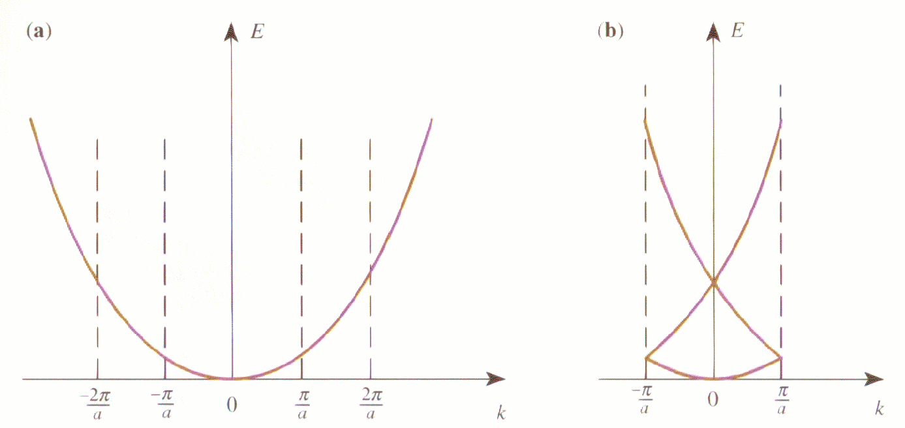
Free Electrons (means U=0) in 1D
U → 0:
Notes:
V=0, so we are in the free electron approximation. These bands will looks a bit different when we turn the potential of the atoms back on.

Slide 5
Free Electrons (means U=0) in 1D
U → 0:
Where k₁ is a wavevector lying in the 1st BZ.
The symmetry of the reciprocal lattice requires:
Notes:
V=0, so we are in the free electron approximation. These bands will looks a bit different when we turn the potential of the atoms back on.

Slide 6
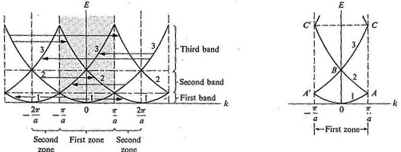
Free Electron Brillouin Zone
Common Methods of Representing the Dispersion Relation E(k)
Repeated Zone Scheme contains a lot of redundant info
First Brillouin Zone
Notes:
k is NOT the momentum of the particle. k acts on the wavefunction does not give an eigenvalue (like E). It’s often referred to as the crystal momentum. Like the classical momentum, it’s frequently conserved. What the difference? The rate of change of a free electron's momentum is proportional to the total force, but the rate of change of an electron's crystal momentum is given only by external forces (applied electric and magnetic field) and does not include the periodic field given by the crystal lattice

Slide 7
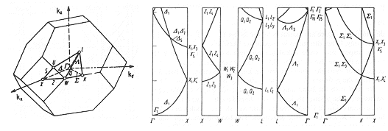
Why does this dispersion relation look different?
L
X
K
fcc in real space
X
X
L
L
K
In a few classes, we will learn to plot these in the zero potential approximation, which is actually pretty good! And look for how to do better.
Sometimes the gaps are larger. We’ll look at why soon.
Notes:
First of all, different because in 3D. (What does that make you think about what we said about divalent systems earlier? Still could be metallic.)
Predict based on nearest neighbor direction in reciprocal space. (Some students might think inverse of magnitude of k, but note not just based on magnitude. 111>110>100, but energy-wise 111<100<110 at the boundary.)

Slide 8
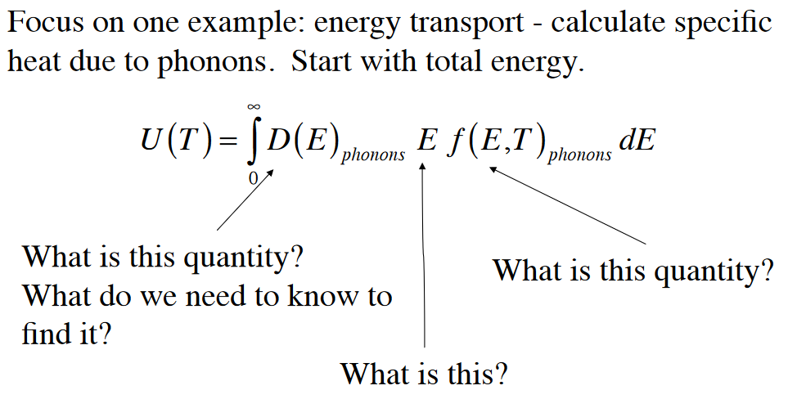
Heat capacity of metals
We mentioned before that in the case of metals, the electronic structure materials more than the phonon contribution.
Let’s look at how we can determine
Energy due to phonons
But there is also energy from the electronic structure. Why did we ignore it before?
Notes:
Before we specifically discussed insulators. And insulators have full bands. So the electronic energy from these does not change much with temperature.
So, we’ll need a similar energy term for the electronic structure. The distribution function will be different for electrons than phonons.
And the Drude model overestimates the heat capacity. So how do we get it right? We need all of these things (density of states, E and the Fermi-Dirac distribution for the electrons too).

Slide 9
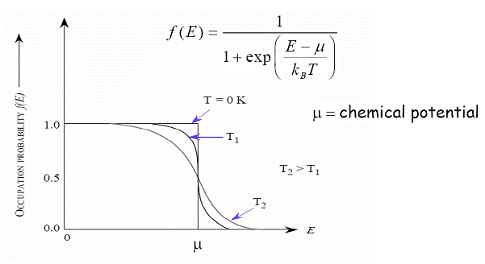
To Determine Thermal Properties, We Need the Fermi-Dirac Distribution
At the chemical potential, there is a 50% chance of finding an electron
I put a derivation of this in the extra slides of last lecture in case you want to see how it’s determined. It’s several steps.
Notes:
Fermi energy is not the same as the chemical potential. µ (T=0)=E_{F}. E_{F} is defined at T=0.
Subtle difference and often confused. Often µ~E_{F}
And, because they are close (or many people just get confused), it’s not uncommon to see the Fermi energy written here instead of the chemical potential. (The chemical potential actually has another meaning besides just when this equal one half. It’s the different in the free energy of the system between N electrons and adding one more.)

Slide 10
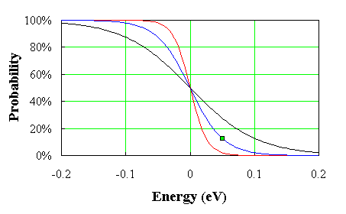
How does this help us understand the problem with Drude’s heat capacity?
When a metal is heated, electrons are transferred from below E_{F} to above E_{F}. The rest of the electrons deep inside the Fermi level are not effected.
But it’s not just f, it’s also related to D(E) or g(E).
Notes:
This was for phonons, but remember I said in metals that electrons would matter too. We have a similar term for electrons

Slide 11

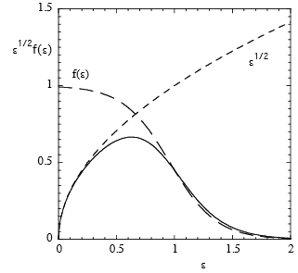
The free electron gas at T < Fermi temp
k
N(E,T)→ number of free electrons per unit energy range is just the area under N(E,T) graph.
N
Big difference at high temps
Notes:
Sorry, I’m using g instead of D for density of states. I need to fix.
You will often see Fermi energy used instead of chemical potential.
F (mu) is still defined the same way, ½ for a semiconductor even though in the gap. It’s just that f(mu) times the density of states changes as the density of states is 0 in the gap.

Slide 12
The shaded area shows the change in distribution between absolute zero and a finite temperature.
N
N(E,T)
Fermi-Dirac distribution function is a symmetric function, meaning:
At low temperatures, the same number of levels below E_{F} is emptied and same number of levels above E_{F} are filled by electrons.
g(E)
T=0
T>0
E
E_{F}

Slide 13
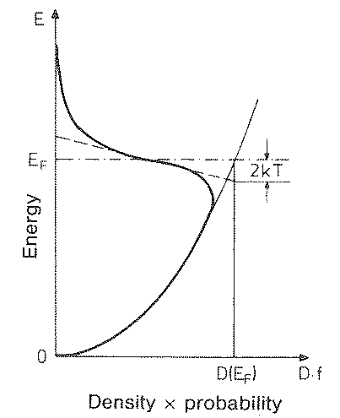
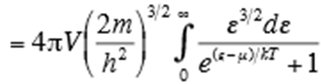
Heat capacity of the free electron gas
Take du/dT
  For an exact calculation:

Slide 14
Heat capacity of the free electron gas
From the diagram of N(E,T) the change in the distribution of electrons can be resembled into triangles of height ½ g(E_{F}) and a base of 2k_{B}T so the area gives that ½ g(E_{F})k_{B}T electrons increased their energy by k_{B}T.
  For an exact calculation:
Take du/dT

Slide 15
Heat capacity of the free electron gas
From the diagram of N(E,T) the change in the distribution of electrons can be resembled into triangles of height ½ g(E_{F}) and a base of 2k_{B}T so the area gives that ½ g(E_{F})k_{B}T electrons increased their energy by k_{B}T.
  The difference in thermal energy from the value at T=0°K
~
  For an exact calculation:

Slide 16
Differentiating with respect to T gives the heat capacity,
Heat capacity of
Free electron gas
Notes:
Specifically, this is the heat capacity at constant volume

Slide 17
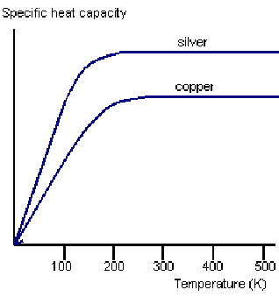
Comparison with Metallic Data
It does appear linear at medium temps
Electrons do not contribute much to room temperature heat capacity (but significant at low temp)
Phonons dominate at high temperatures but this works well for metals at medium temperatures
Classical Model suggests one constant value and same value for all materials

Slide 18
Besides conductivity and its change with temperature,
are there other ways to determine if something is a metal versus a semiconductor or insulator?

Slide 19
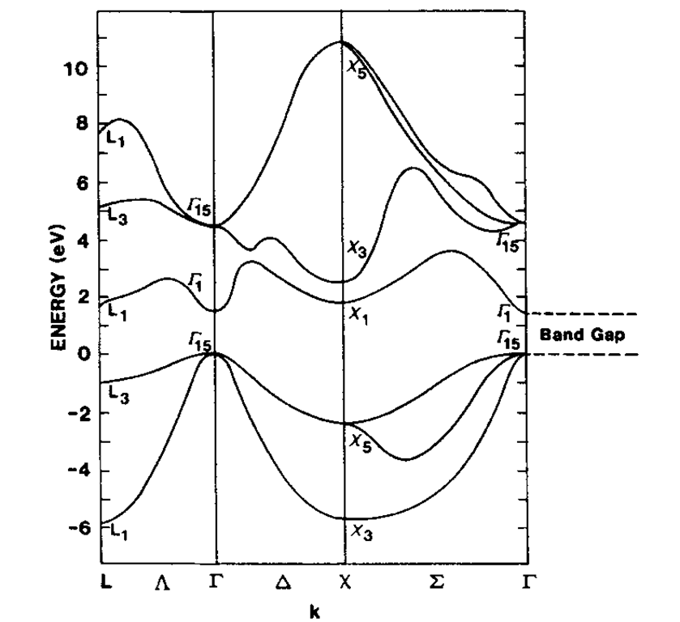
You can tell from the energy band diagram (this is not the phonon dispersion curve)
Real materials have gaps in the available levels
GaAs
It’s not obvious in this one, but a little bending near BZ edges.
Notes:
Note phonon dispersion curve looked linear at small k and this looks quadratic.
Analogy: Not every distance away from the center of the stage has a seat. Not every potential energy has a seat.
We’ll talk directly about semiconductors and insulators in a few classes. Today our goal is to understand where energy bands and gaps come from.
Technically gaps come from bringing atoms closer together. Yet, the square well model would not make it clear why this happens because we ignore the potential of the atoms

Slide 20
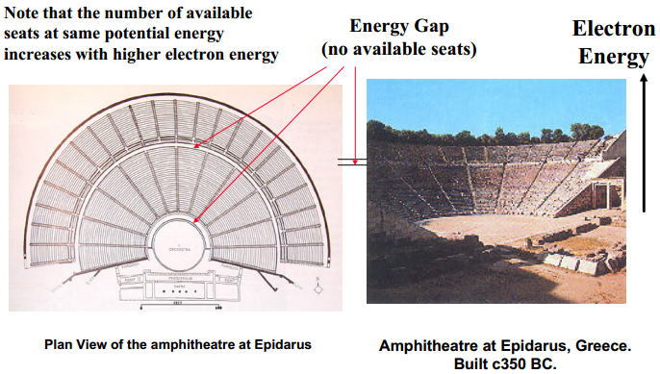
GaAs
Real materials have gaps in the available levels
Notes:
Analogy: Not every distance away from the center of the stage has a seat. Not every potential energy has a seat.
We’ll talk directly about semiconductors and insulators in a few classes. Today our goal is to understand where energy bands and gaps come from.
Technically gaps come from bringing atoms closer together. Yet, the square well model would not make it clear why this happens because we ignore the potential of the atoms

Slide 21
GaAs
Real materials have gaps in the available levels
Metals have available states just above the Fermi level
Notes:
Analogy: Not every distance away from the center of the stage has a seat. Not every potential energy has a seat.
We’ll talk directly about semiconductors and insulators in a few classes. Today our goal is to understand where energy bands and gaps come from.
Technically gaps come from bringing atoms closer together. Yet, the square well model would not make it clear why this happens because we ignore the potential of the atoms

Slide 22
Where do energy bands and gaps come from? (a few approaches)
GaAs
Real materials have gaps in the available levels
Metals have available states just above the Fermi level
Texts for Today’s Discussion:
Kittel: pages 162-176
Ashcroft & Mermin: pages 152-161 and 176-188
Snoke: pages 1-14
Notes:
Analogy: Not every distance away from the center of the stage has a seat. Not every potential energy has a seat.
We’ll talk directly about semiconductors and insulators in a few classes. Today our goal is to understand where energy bands and gaps come from.
Technically gaps come from bringing atoms closer together. Yet, the square well model would not make it clear why this happens because we ignore the potential of the atoms

Slide 23
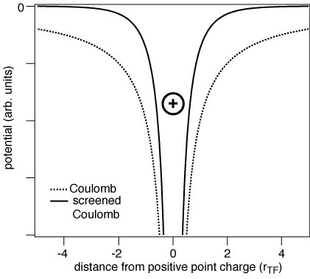
“Realistic” Atomic Potentials in Solids
Multi-electron atomic potentials are complex
Even for hydrogen atom with a “simple” Coulomb potential solutions are quite complex
That’s why we started by ignoring the potential all together.
That got us close, but didn’t explain gaps.
U
U=0
0
L

Slide 24
Right: Ignoring gaps would actually be pretty close
Left material: Not so much
GaAs
We’ll learn how to calculate these bands ignoring gaps next time.
The empty lattice is a good start and works well for many materials.
Notes:
Left: GaAs
Right: Not sure which fcc material, but looks like an elemental system. Low interactions as it basically looks just like an empty lattice.

Slide 25
What do physicists do when complex?
“Realistic” Atomic Potentials are complex
We figure out how to simplify it.
If taking one well for the whole metal was too simple, we can take a step further by…

Slide 26
Quantum Well for Each Atom Rather than a Giant Quantum Well for the Metal
Quantum/Atomic Physics
Notes:
So, instead of having single atomic energy levels, we get bands were many energy levels exist.
Let’s see how these bands develop as we go from one atom to multiple atoms.
While square wells are a simplification, it turns out we still learn a lot from the exercise. The general trend is still the same in the more complicated potentials.

Slide 27
Quantum Well for Each Atom Rather than a Giant Quantum Well for the Metal
Single Atom
Before we go to an infinite chain, let’s remind ourselves what happens with just two wells.
Simplest Periodic Potential
Multiple Atoms (Condensed Matter Physics)
Notes:
So, instead of having single atomic energy levels, we get bands were many energy levels exist.
Let’s see how these bands develop as we go from one atom to multiple atoms.
While square wells are a simplification, it turns out we still learn a lot from the exercise. The general trend is still the same in the more complicated potentials.

Slide 28
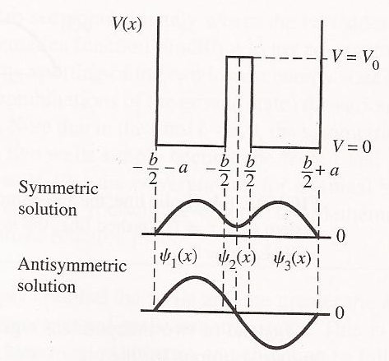
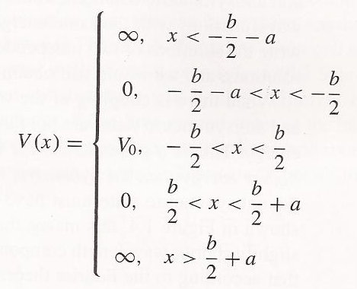
Approach 1: Get atoms close (conceptual)
Ideal Double Quantum Wells
How do we start?
Notes:
Symmetric has higher chance of finding electron between the wells (states also known as bonding and antibonding)
Reference about double well: http://www.hep.manchester.ac.uk/u/forshaw/BoseFermi/Double%20Well.html
If we didn’t want an ideal well, we could use periodic boundary conditions.
Didn’t need the derivative for the single well, redundant information
What’s the difference between these two wavefunctions? Energy. Talk about probably of being found in between and that’s relation to bonding.
Can you see mathematically, why energy would be a little different (fourier theorem of adding sine waves, quick changes require higher frequency terms)

Slide 29
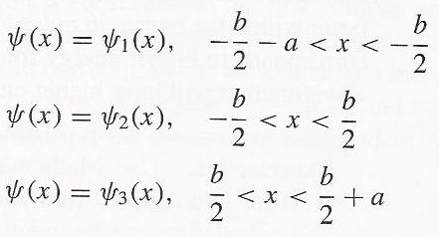
Approach 1: Get atoms close (conceptual)
Ideal Double Quantum Wells
How do we start?
The wavefunction has three regions
Notes:
Symmetric has higher chance of finding electron between the wells (states also known as bonding and antibonding)
Reference about double well: http://www.hep.manchester.ac.uk/u/forshaw/BoseFermi/Double%20Well.html
If we didn’t want an ideal well, we could use periodic boundary conditions.
Didn’t need the derivative for the single well, redundant information
What’s the difference between these two wavefunctions? Energy. Talk about probably of being found in between and that’s relation to bonding.
Can you see mathematically, why energy would be a little different (fourier theorem of adding sine waves, quick changes require higher frequency terms)

Slide 30
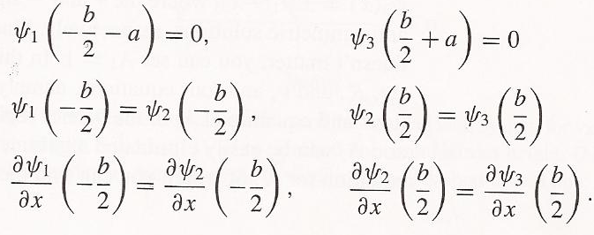
Approach 1: Get atoms close (conceptual)
Ideal Double Quantum Wells
How do we start?
The wavefunction has three regions
Notes:
Symmetric has higher chance of finding electron between the wells (states also known as bonding and antibonding)
Reference about double well: http://www.hep.manchester.ac.uk/u/forshaw/BoseFermi/Double%20Well.html
If we didn’t want an ideal well, we could use periodic boundary conditions.
Didn’t need the derivative for the single well, redundant information
What’s the difference between these two wavefunctions? Energy. Talk about probably of being found in between and that’s relation to bonding.
Can you see mathematically, why energy would be a little different (fourier theorem of adding sine waves, quick changes require higher frequency terms)

Slide 31
Approach 1: Get atoms close (conceptual)
Ideal Double Quantum Wells
How do we start?
The wavefunction has three regions
Notes:
Symmetric has higher chance of finding electron between the wells (states also known as bonding and antibonding)
Reference about double well: http://www.hep.manchester.ac.uk/u/forshaw/BoseFermi/Double%20Well.html
If we didn’t want an ideal well, we could use periodic boundary conditions.
Didn’t need the derivative for the single well, redundant information
What’s the difference between these two wavefunctions? Energy. Talk about probably of being found in between and that’s relation to bonding.
Can you see mathematically, why energy would be a little different (fourier theorem of adding sine waves, quick changes require higher frequency terms)

Slide 32
Approach 1: Get atoms close (conceptual)
Ideal Double Quantum Wells
How do we start?
The wavefunction has three regions
Notes:
Symmetric has higher chance of finding electron between the wells (states also known as bonding and antibonding)
Reference about double well: http://www.hep.manchester.ac.uk/u/forshaw/BoseFermi/Double%20Well.html
If we didn’t want an ideal well, we could use periodic boundary conditions.
Didn’t need the derivative for the single well, redundant information
What’s the difference between these two wavefunctions? Energy. Talk about probably of being found in between and that’s relation to bonding.
Can you see mathematically, why energy would be a little different (fourier theorem of adding sine waves, quick changes require higher frequency terms)

Slide 33
Approach 1: Get atoms close (conceptual)
Ideal Double Quantum Wells
How do we start?
Which more likely to find electron in middle?
Notes:
Symmetric has higher chance of finding electron between the wells (states also known as bonding and antibonding)
Reference about double well: http://www.hep.manchester.ac.uk/u/forshaw/BoseFermi/Double%20Well.html
If we didn’t want an ideal well, we could use periodic boundary conditions.
Didn’t need the derivative for the single well, redundant information
What’s the difference between these two wavefunctions? Energy. Talk about probably of being found in between and that’s relation to bonding.
Can you see mathematically, why energy would be a little different (fourier theorem of adding sine waves, quick changes require higher frequency terms)

Slide 34
Approach 1: Get atoms close (conceptual)
Ideal Double Quantum Wells
How would it change if non-ideal well?
How do we start?
Which more likely to find electron in middle?
Notes:
Symmetric has higher chance of finding electron between the wells (states also known as bonding and antibonding)
Reference about double well: http://www.hep.manchester.ac.uk/u/forshaw/BoseFermi/Double%20Well.html
If we didn’t want an ideal well, we could use periodic boundary conditions.
Didn’t need the derivative for the single well, redundant information
What’s the difference between these two wavefunctions? Energy. Talk about probably of being found in between and that’s relation to bonding.
Can you see mathematically, why energy would be a little different (fourier theorem of adding sine waves, quick changes require higher frequency terms)

Slide 35
A Small Barrier Adjusts the Energies and Wavefunctions
Non-ideal single well

Slide 36
A Small Barrier Adjusts the Energies and Wavefunctions
Non-ideal single well
Non-ideal double well

Slide 37
A Small Barrier Adjusts the Energies and Wavefunctions
Non-ideal single well
Non-ideal double well

Slide 38
Increasing the Barrier Moves the Symmetric and Antisymmetric Closer
Larger barrier
Smaller barrier
Notes:
It depends on the shape of the orbital as to which is lower energy. An s orbital will prefer symmetric alignment. You can imagine this by overlapping to circles. They share the electrons to some degree. It will be easier if the spin doesn’t have to change.

Slide 39
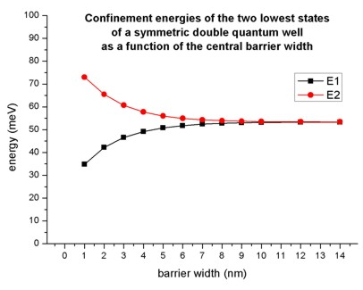
Increasing the Barrier Moves the Symmetric and Antisymmetric Closer
Larger barrier
Smaller barrier
What happens as make b go to 0?
Notes:
It depends on the shape of the orbital as to which is lower energy. An s orbital will prefer symmetric alignment. You can imagine this by overlapping to circles. They share the electrons to some degree. It will be easier if the spin doesn’t have to change.

Slide 40
Increasing the Barrier Moves the Symmetric and Antisymmetric Closer
What would 3 wells look like?
Larger barrier
Smaller barrier
What happens as make b go to 0?
Notes:
It depends on the shape of the orbital as to which is lower energy. An s orbital will prefer symmetric alignment. You can imagine this by overlapping to circles. They share the electrons to some degree. It will be easier if the spin doesn’t have to change.

Slide 41
Triple Quantum Wells
Which has the lowest energy?
Single well
Any relation between nodes and energy?
Notes:
@ Nodes, ampitude=0

Slide 42
Quadruple Quantum Square Wells

Slide 43
Five Quantum Square Wells

Slide 44
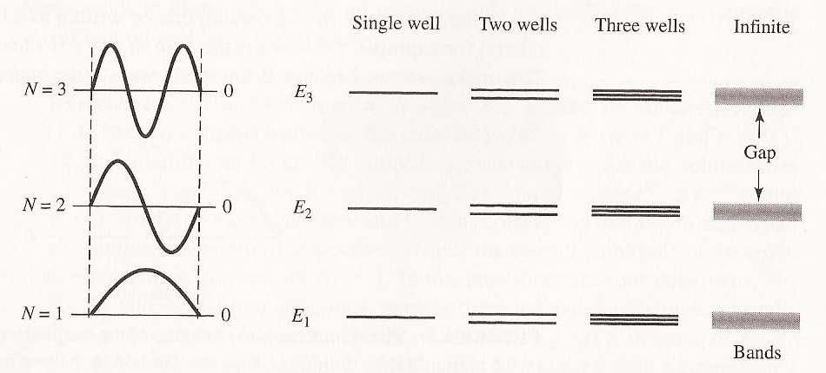
Comparing Energy Levels
How would the energy levels look for multiple wells?

Slide 45
How Energy Bands Form

Slide 46
How Energy Bands Form
What happens to these levels as the atoms get closer (b smaller)?

Slide 47
How Energy Bands Form
What happens to these levels as the atoms get closer (b smaller)?

Slide 48
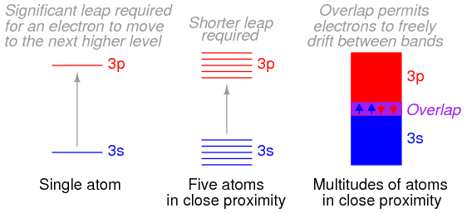
Band Overlap
Often the higher energy bands become so wide that they overlap with the lower bands
Why might this matter?
Notes:
Reminder: Why do bands get wider? Bring atoms closer together.
For reminder of hybridization from energy level perspective:
https://www.khanacademy.org/science/organic-chemistry/gen-chem-review/hybrid-orbitals-jay/v/sp3-hybridized-orbitals-and-sigma-bonds

Slide 49
Band Overlap
Often the higher energy bands become so wide that they overlap with the lower bands
Many materials are conductors (metals) due to the “band overlap” phenomenon
Notes:
Reminder: Why do bands get wider? Bring atoms closer together.
For reminder of hybridization from energy level perspective:
https://www.khanacademy.org/science/organic-chemistry/gen-chem-review/hybrid-orbitals-jay/v/sp3-hybridized-orbitals-and-sigma-bonds

